Slide 1
Lecture 7: Subnetting IP Networks

Slide 2
7.1 Subnetting an IPv4 Network

Slide 3
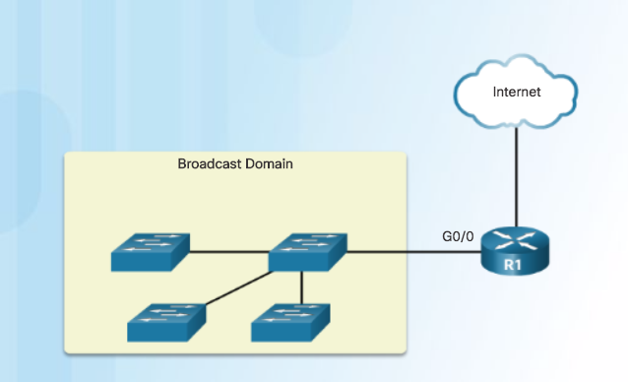
Network Segmentation Broadcast Domains
Devices use broadcasts in an Ethernet LAN to locate:
Other devices - Address Resolution Protocol (ARP) which sends Layer 2 broadcasts to a known IPv4 address on the local network to discover the associated MAC address.
Services – Dynamic Host Configuration Protocol (DHCP) which sends broadcasts on the local network to locate a DHCP server.
Switches propagate broadcasts out all interfaces except the interface on which it was received.

Slide 4
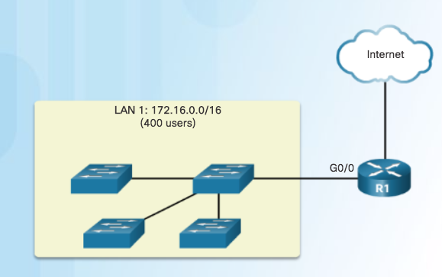
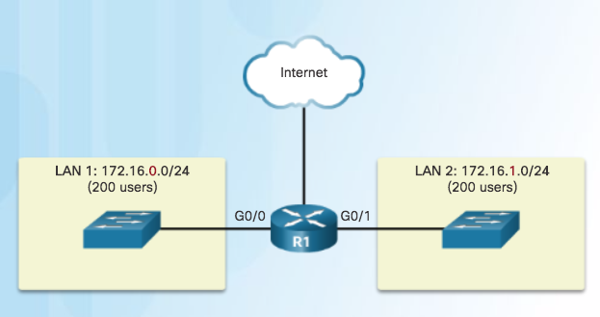
Network Segmentation Problems with Large Broadcast Domains
Hosts can generate excessive broadcasts and negatively affect the network.
Slow network operations due to the significant amount of traffic it can cause.
Slow device operations because a device must accept and process each broadcast packet.
Solution: Reduce the size of the network to create smaller broadcast domains. These smaller network spaces are called subnets.
One Broadcast Domain
Broadcast in LAN 1 contained in 1 subnet
Broadcast in LAN 2 contained in 1 subnet

Slide 5
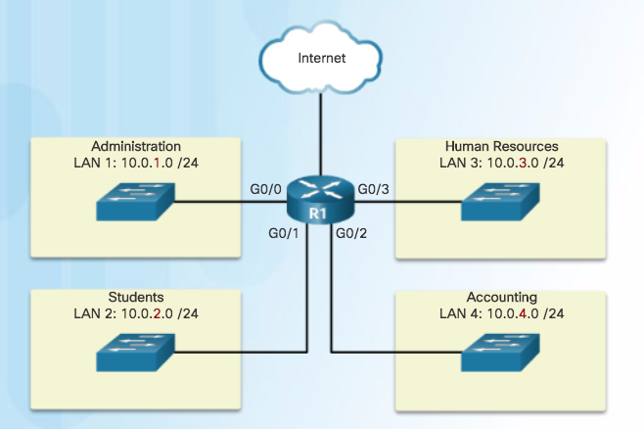
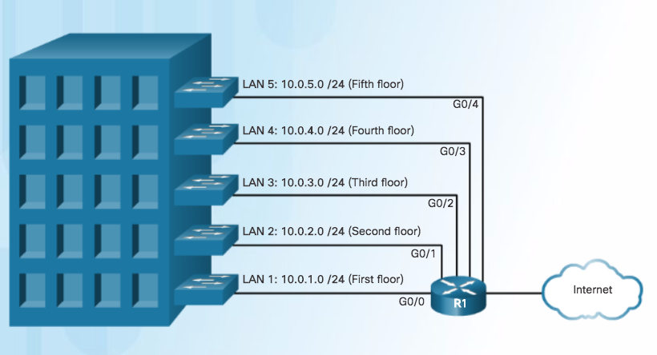
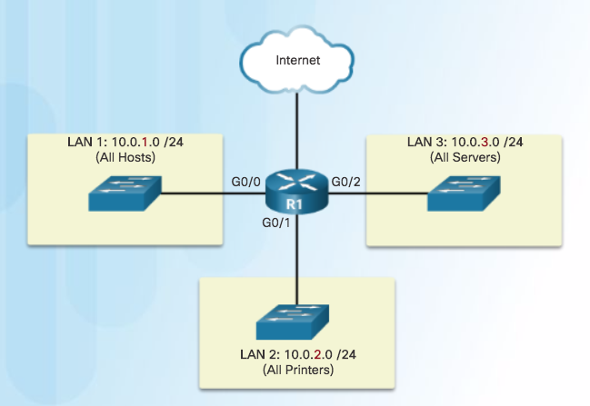
Network Segmentation Reasons for Subnetting
Reduces overall network traffic and improves network performance.
Enables an administrator to implement security policies such as which subnets are allowed or not allowed to communicate together.
Communicating between
Networks
Subnetting by Location
Subnetting by Device Type

Slide 6
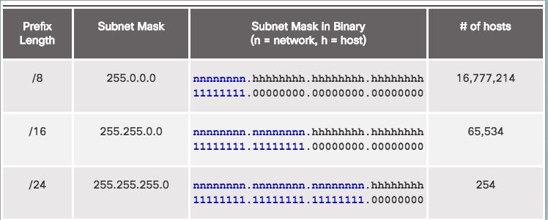
Subnetting an IPv4 Network Octet Boundaries
Networks are most easily subnetted at the
octet boundary of /8, /16, and /24
Prefix length and the subnet mask are different ways of identifying the network portion of an address.
Subnets are created by borrowing host bits for network bits.
More host bits borrowed, the more subnets that can be defined.

Slide 7
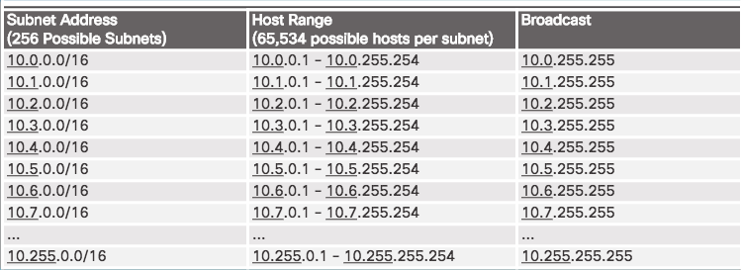
Subnetting an IPv4 Network Subnetting on the Octet Boundary
Subnetting Network 10.x.0.0/16
Define up to 256 subnets with each subnet capable of connecting 65,534 hosts.
First two octets identify the network portion while the last two octets are for host IP addresses.

Slide 8
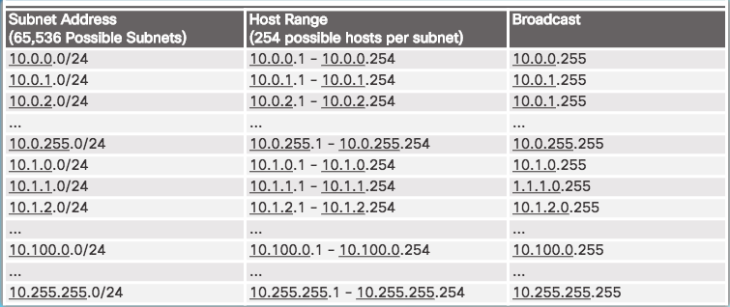
Subnetting an IPv4 Network Subnetting on the Octet Boundary (Cont.)
Subnetting Network 10.x.x.0/24
Define 65,536 subnets each capable of connecting 254 hosts.
/24 boundary is very popular in subnetting because of number of hosts.

Slide 9
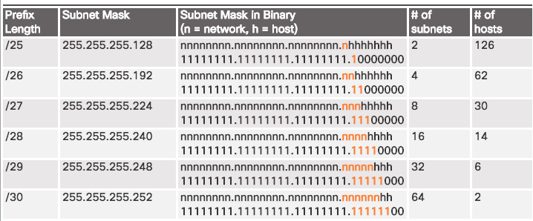
Subnetting an IPv4 Network Classless Subnetting
Subnetting a /24 Network
Subnets can borrow bits from any host bit position to create other masks.

Slide 10
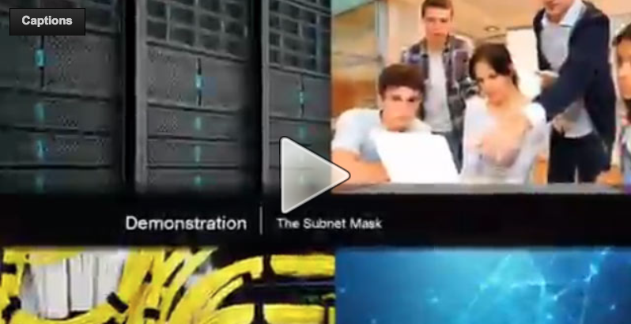
Subnetting an IPv4 Network The Subnet Mask
Subnetting in Binary
ANDING
Convert IP address and Subnet Mask to Binary (line up vertically like an addition problem)
Logically AND (1 and 1 = 1, all other combinations = 0)
Result is network address for original IP address
Classful Subnetting
Class A /8 255.0.0.0
Class B /16 255.255.0.0
Class C /24 255.255.255.0

Slide 11
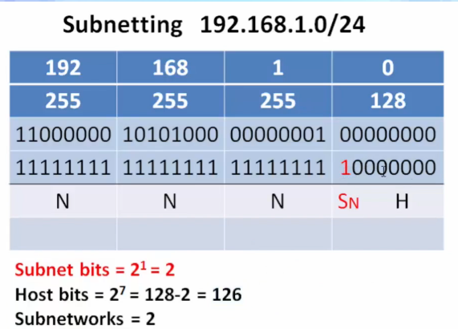
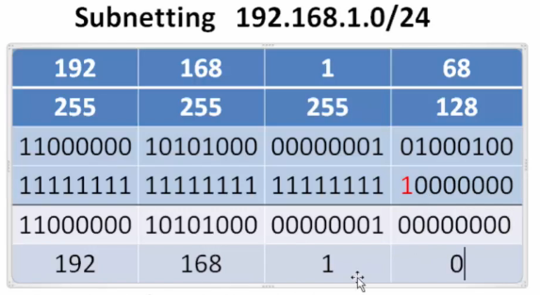

Subnetting an IPv4 Network Video Demonstration – The Subnet Mask (Cont.)

Slide 12
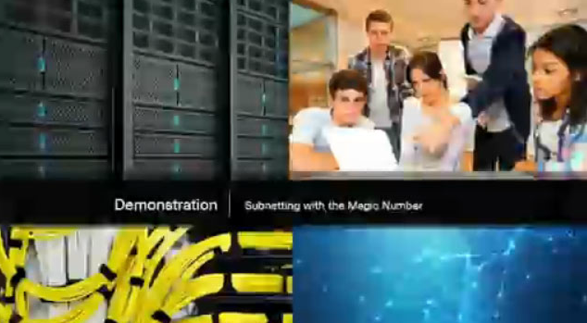
Subnetting an IPv4 Network Video Demonstration – Subnetting with the Magic Number
Magic number technique used to calculate subnets
Magic number is simply the place value of the last one in the subnet mask
/25 11111111.11111111.11111111.10000000 magic number = 128
/26 11111111.11111111.11111111.11000000 magic number = 64
/27 11111111.11111111.11111111.11100000 magic number = 32

Slide 13
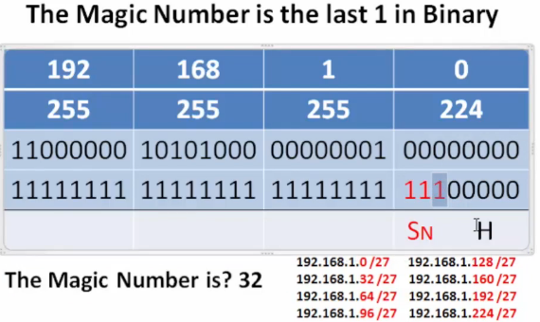
Subnetting an IPv4 Network Video Demonstration – Subnetting with the Magic Number (Cont.)

Slide 14
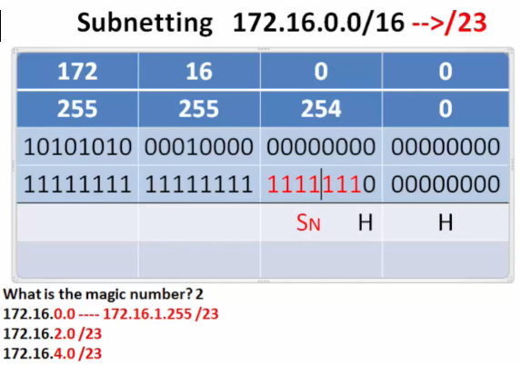
Subnetting an IPv4 Network Video Demonstration – Subnetting with the Magic Number (Cont.)

Slide 15
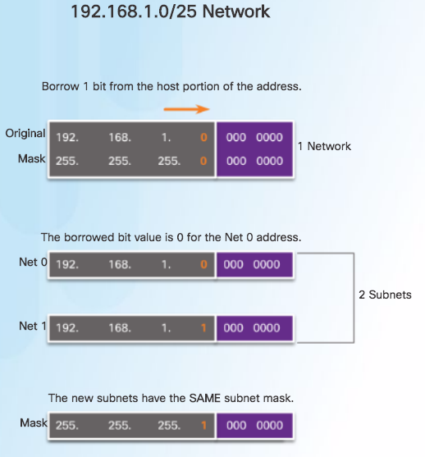
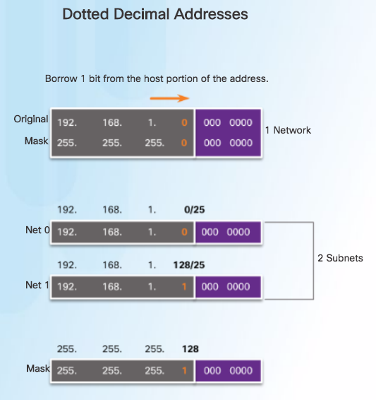
Subnetting an IPv4 Network Classless Subnetting Example

Slide 16
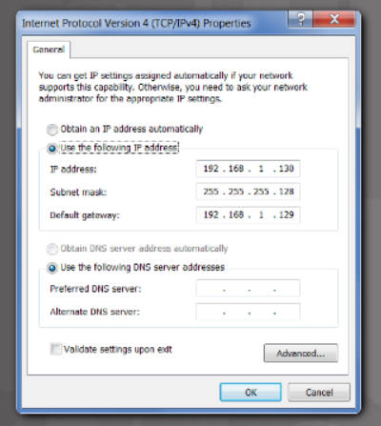
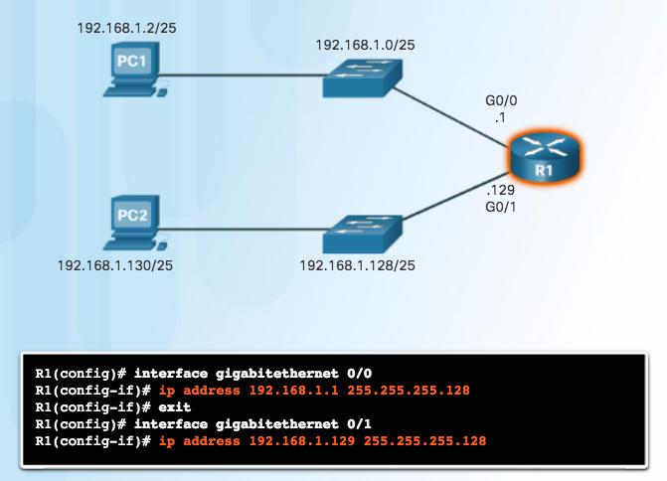
Subnetting an IPv4 Network Creating 2 Subnets
/25 Subnetting Topology

Slide 17
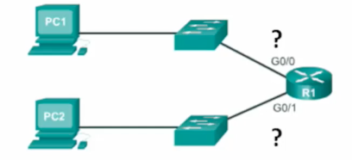
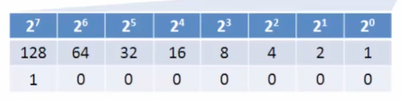
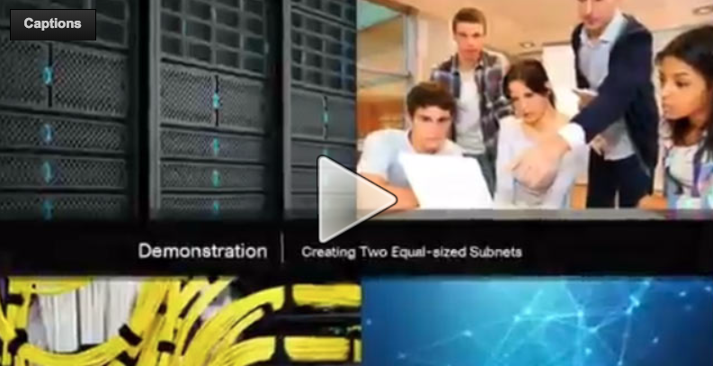
Subnetting an IPv4 Network Video Demonstration – Creating Two Equal-sized Subnets (/25)
Create 2 Equal-sized Subnets from 192.168.1.0 /24
Subnet Mask - 11111111.11111111.11111111.10000000
Magic Number = 128
192.168.1.0 /25 (start at 0)
192.168.1.128 /25 (Add 128)

Slide 18
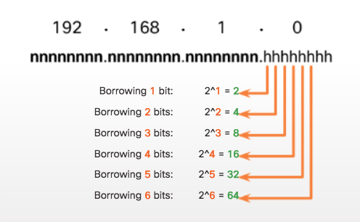
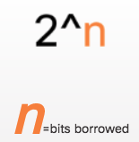
Subnetting an IPv4 Network Subnetting Formulas
Calculate Number of Subnets Formula
Subnetting a /24 Network

Slide 19
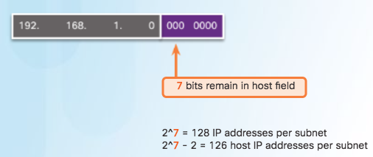
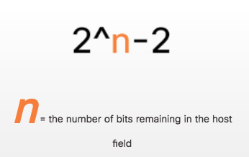
Subnetting an IPv4 Network Subnetting Formulas (Cont.)
Calculate Number of Hosts Formula
Calculating the Number of Hosts

Slide 20
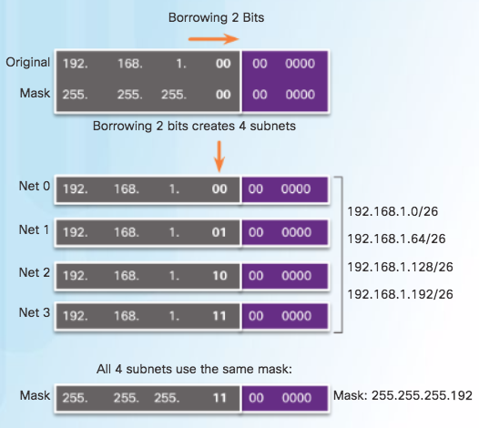
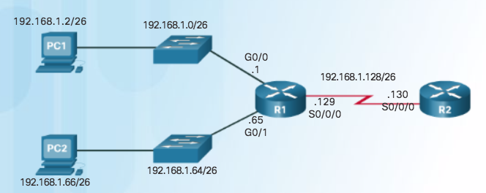
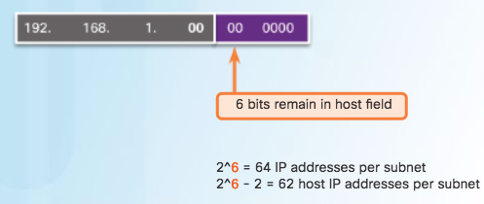
Subnetting an IPv4 Network Creating 4 Subnets
/26 Subnetting Topology

Slide 21
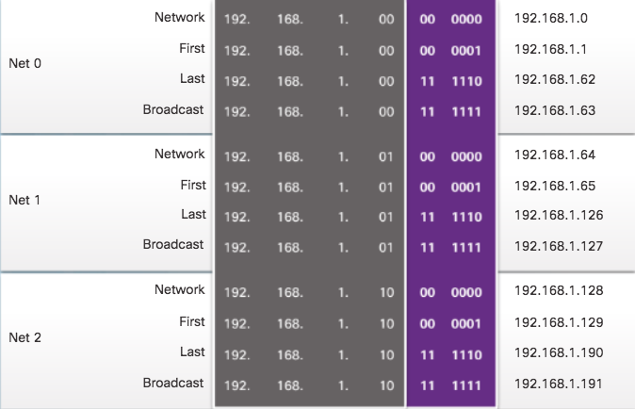
Subnetting an IPv4 Network Creating 4 Subnets (Cont.)
/26 Subnetting Topology

Slide 22
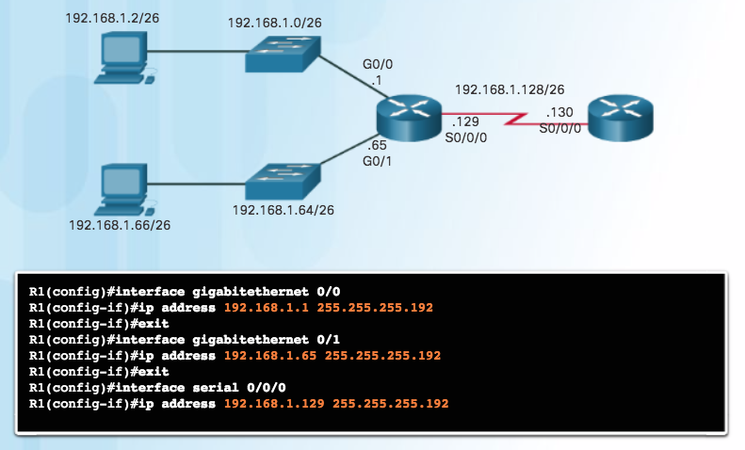
Subnetting an IPv4 Network Creating 4 Subnets (Cont.)
/26 Subnetting Topology

Slide 23
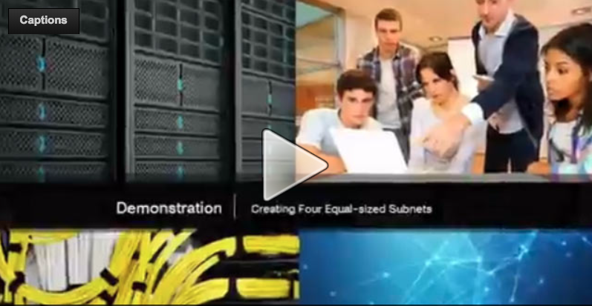
Subnetting an IPv4 Network Video Demonstration – Creating Four Equal-sized Subnets (/26)
Create 4 Equal-sized Subnets from 192.168.1.0 /24
Subnet Mask in Binary – 11111111.11111111.11111111.11000000
2^2 = 4 Subnets
Magic Number = 64
192.168.1.0 /26
192.168.1.64 /26
192.168.1.128 /26
192.168.1.192 /26

Slide 24
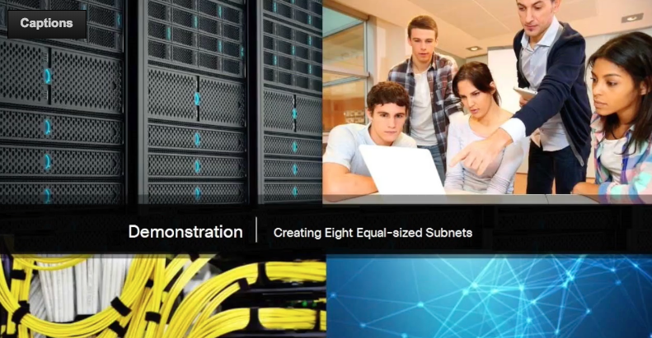
Subnetting an IPv4 Network Video Demonstration – Creating Eight Equal-sized Subnets (/27)
Create 8 Equal-sized Subnets from 192.168.1.0 /24
Borrow 3 bits – 11111111.11111111.11111111.11100000
Magic Number = 32
192.168.1.0 /27 (Start at 0)
192.168.1.32 /27 (Add 32 to previous network)
192.168.1.64 /27 (Add 32)
192.168.1.96 /27 (Add 32)
192.168.1.128 /27 (Add 32)
192.168.1.160 /27 (Add 32)
192.168.1.192 /27 (Add 32)
192.168.1.224 /27 (Add 32)

Slide 25
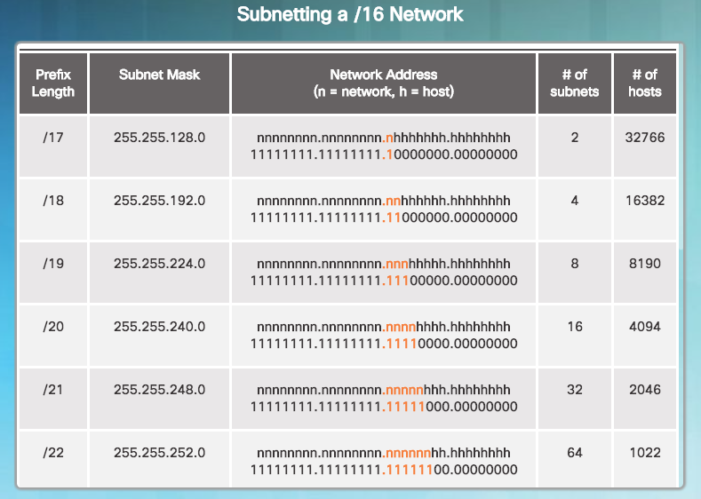
Subnetting a /16 and /8 Prefix Creating Subnets with a /16 prefix

Slide 26
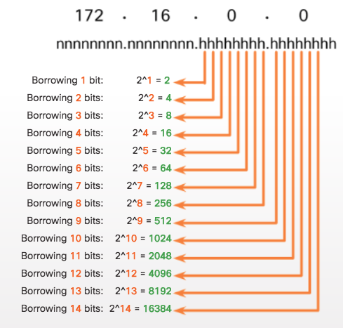
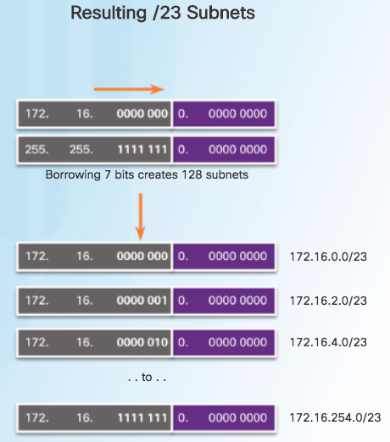
Subnetting a /16 and /8 Prefix Creating 100 Subnets with a /16 prefix

Slide 27
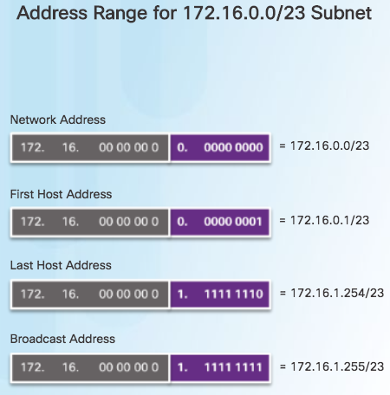
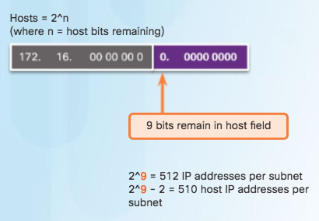
Subnetting a /16 and /8 Prefix Calculating the Hosts

Slide 28
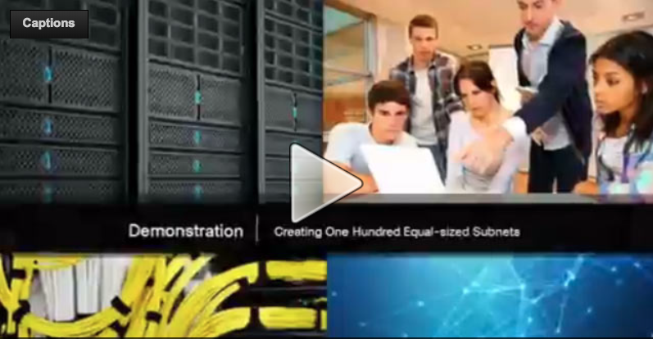
Subnetting a /16 and /8 Prefix Video Demonstration – Creating One Hundred Equal-sized Subnets
An enterprise network requires 100 equal-sized subnets starting from 172.16.0.0/16
New Subnet Mask
11111111.11111111.11111110.00000000
2^7 = 128 Subnets
2^9 = 512 hosts per subnet
Magic Number = 2
172.16.0.0 /23
172.16.2.0 /23
172.16.4.0 /23
172.16.6.0 /23
…
172.16.254.0 /23

Slide 29
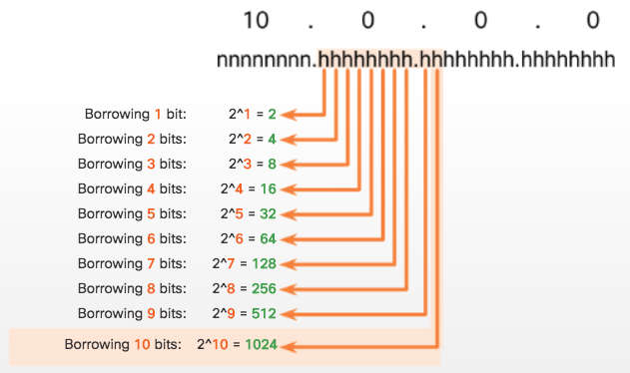
Subnetting a /16 and /8 Prefix Creating 1000 Subnets with a /8 Network

Slide 30
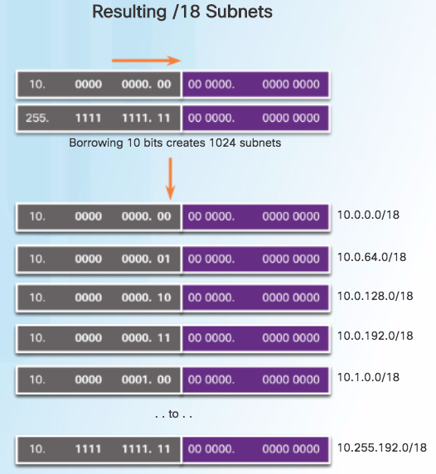
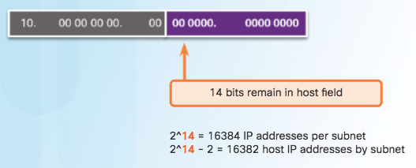
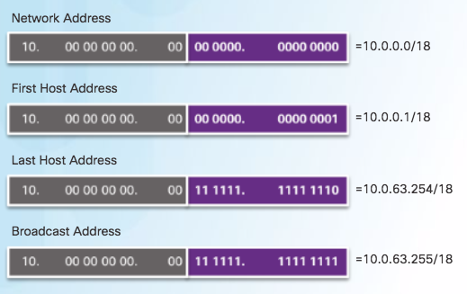
Subnetting a /16 and /8 Prefix Creating 1000 Subnets with a /8 Network (Cont.)

Slide 31
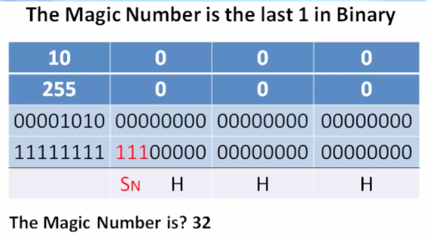
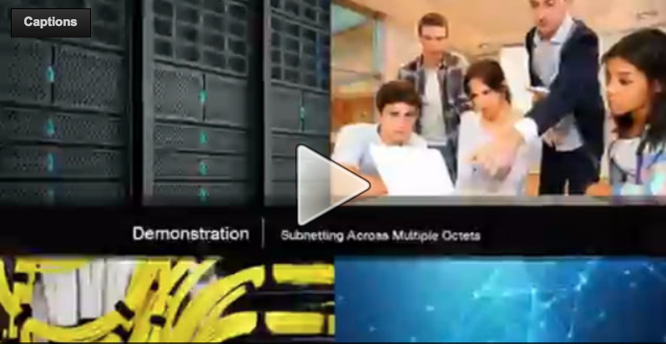

Subnetting a /16 and /8 Prefix Video Demonstration – Subnetting Across Multiple Octets
New Challenge Problem: Create over 300 Equal-sized Subnets of 20,000 Hosts each starting from 10.0.0.0/8

Slide 32
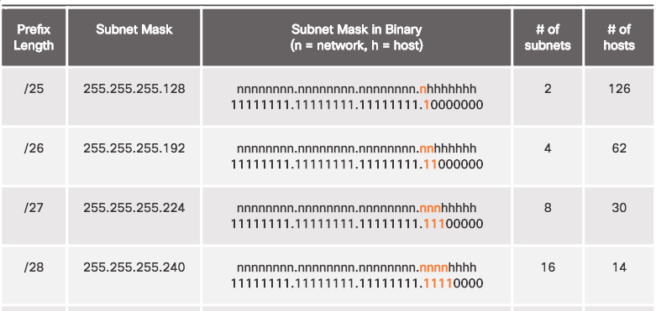
Subnetting to Meet Requirements Subnetting Based on Host Requirements

Slide 33
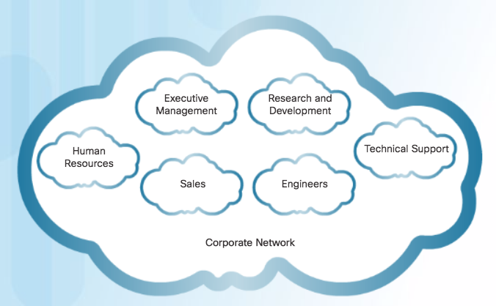
Subnetting to Meet Requirements Subnetting Based On Network Requirements
Host devices used by employees in the Engineering department in one network and Management in a separate network.

Slide 34
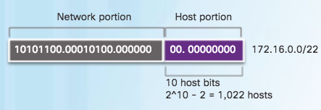
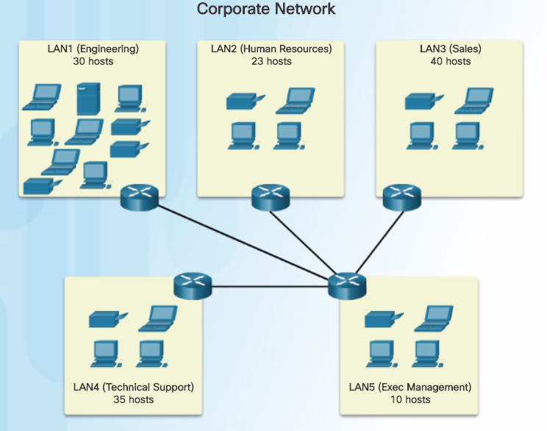

Subnetting to Meet Requirements Network Requirement Example

Slide 35

Subnetting to Meet Requirements Network Requirement Example (Cont.)

Slide 36



Benefits of Variable Length Subnet Masking Traditional Subnetting Wastes Addresses

Slide 37


Benefits of Variable Length Subnet Masking Variable Length Subnet Masks (VLSM)
Traditional
Subnets of Varying Sizes

Slide 38


Benefits of Variable Length Subnet Masking Basic VLSM
Basic Subnetting

Slide 39


Benefits of Variable Length Subnet Masking Video Demonstration – VLSM Basics
Basic VLSM
Subnets do not have to be equal sizes, as long as their address ranges do not overlap.
When creating subnets it is easier to work from larger to smaller.

Slide 40

Benefits of Variable Length Subnet Masking VLSM in Practice

Slide 41

Benefits of Variable Length Subnet Masking VLSM Chart

Slide 42


Benefits of Variable Length Subnet Masking Video Demonstration – VLSM Example
Given the network 172.16.0.0 /23 creates subnets:
1 network for 200 hosts - 256
1 network for 100 hosts - 128
1 network for 50 hosts - 64
1 network for 25 hosts - 32
1 network for 10 hosts - 16
4 point-to-point networks for 2 hosts each – 4x4 = 16
/23 = 2^9 hosts = 512
256+128+64+32+16+16 = 512 hosts needed
Address range 172.16.0.0 – 172.16.1.255
172.16.1.248 /30 (4)
172.16.1.252 /30 (4)

Slide 43
7.2 Addressing Schemes
Notes:
8 – Subnetting IP Networks
8.2 – Addressing Schemes

Slide 44

Structured Design Network Address Planning

Slide 45

Structured Design Planning to Address the Network
Each host in an internetwork must have a unique address.
Need proper planning & documentation.
Must provide & control access to servers from internal hosts and external hosts.
Layer 3 STATIC address assigned to a server can be used to control access to that server.
Monitoring security and performance of hosts means network traffic is examined for source IP addresses that are generating or receiving excessive packets.

Slide 46

Structured Design Assigning Addresses to Devices
Devices that require addresses:
End user clients
Can be set for DHCP to save time and manual errors.
A change in the subnetting scheme requires reconfiguration of DHCP server. IPv6 clients use DHCPv6/SLAAC.
Servers
Configured with static addresses.
Private addresses translated to public addresses if accessible from the Internet.
Intermediary devices
Set with static addresses for remote management.
Gateway
Router interface used to exit the network.

Slide 47
7.3 Design Considerations for IPv6

Slide 48


Subnetting an IPv6 Network The IPv6 Global Unicast Address
IPv6 subnetting is not concerned with conserving address space.
IPv6 subnetting is about building an addressing hierarchy based on the number of subnetworks needed.
IPv6 link-local address is never subnetted.
IPv6 global unicast address can be subnetted.
IPv6 global unicast address normally consists of a /48 global routing prefix, a 16 bit subnet ID, and a 64 bit interface ID.
Structure

Slide 49

Subnetting an IPv6 Network Subnetting Using the Subnet ID

Slide 50



Subnetting an IPv6 Network IPv6 Subnet Allocation

